Slide 1
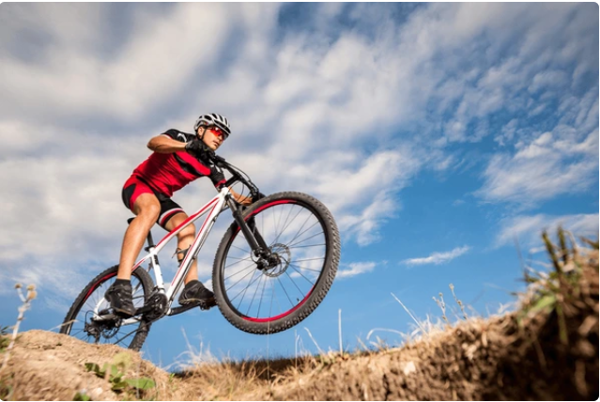

Adventure Works Sales Performance & Customer Analysis
Presented by: Sonam

Slide 2






TABLE OF CONTENT
01
02
03
Technology used
Introduction
Problem Statement
04
Dashboard Description
05
06
Product Performance
Sales Performance Analysis
07
08
09
Key Performance Indicator
Data highlights
Key Findings
10
11
12
Recommendations & Actions
Conclusion & Next Step
Team Acknowledgement

Slide 3


Introduction
Overview
Adventure works dataset represents it’s companies products specializing in bicycles and related products
Objective
Analyzed four years (2010-2014) of transactional data from Adventure works cycles, a manufacturing company, to access performance and identify profit trends.

Slide 4

Problem Statement
Adventure work cycles required an analysis of its sales data to identify profitable products, key customer locations and sales trends.
The goal was to transform raw data into actionable insights to guide strategic business decisions and enhance performance.

Slide 5





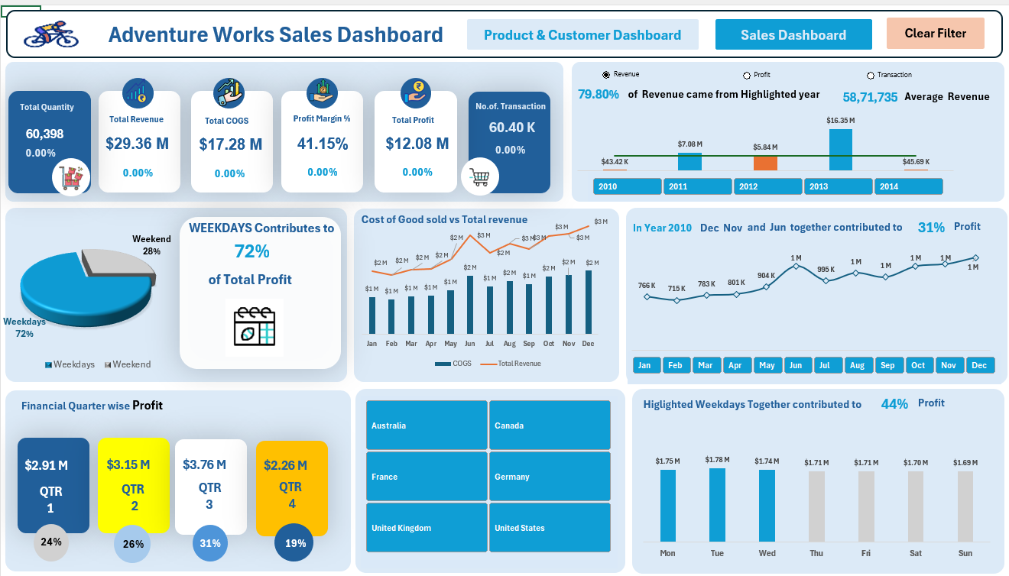
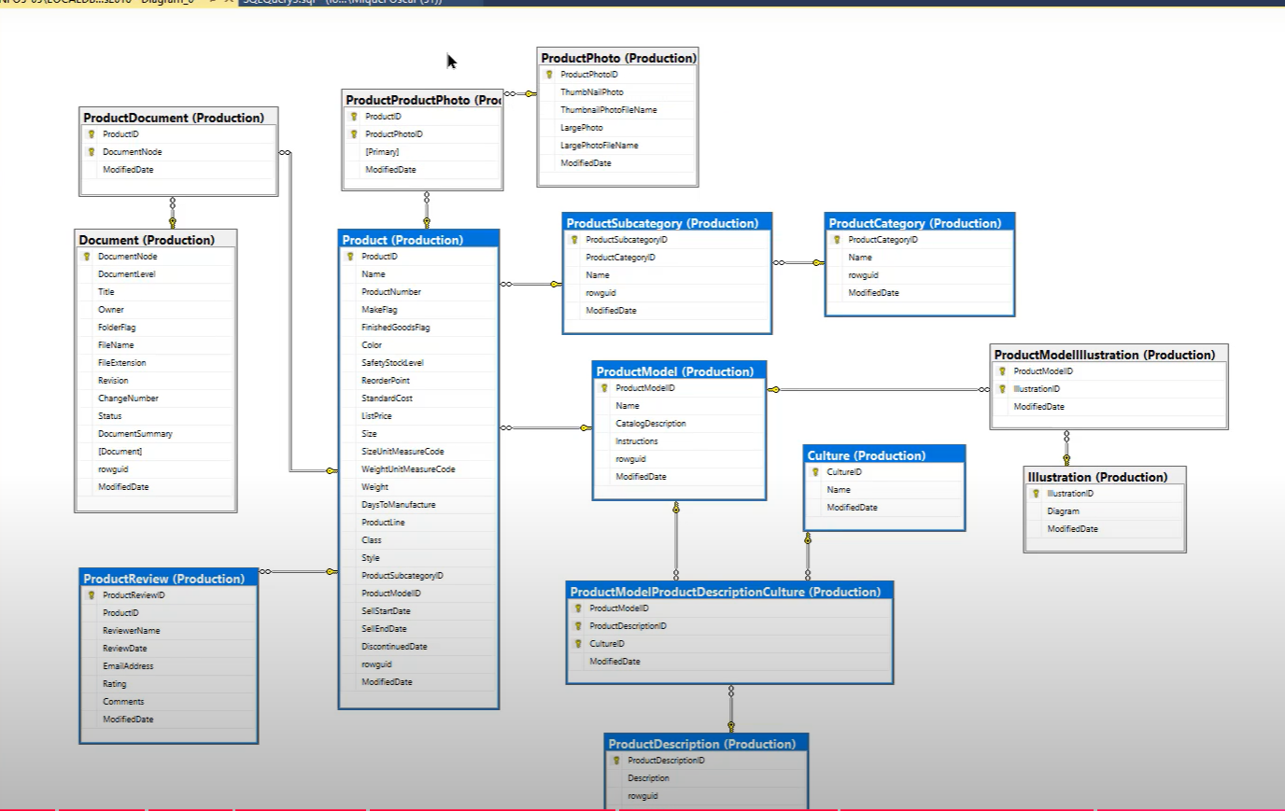
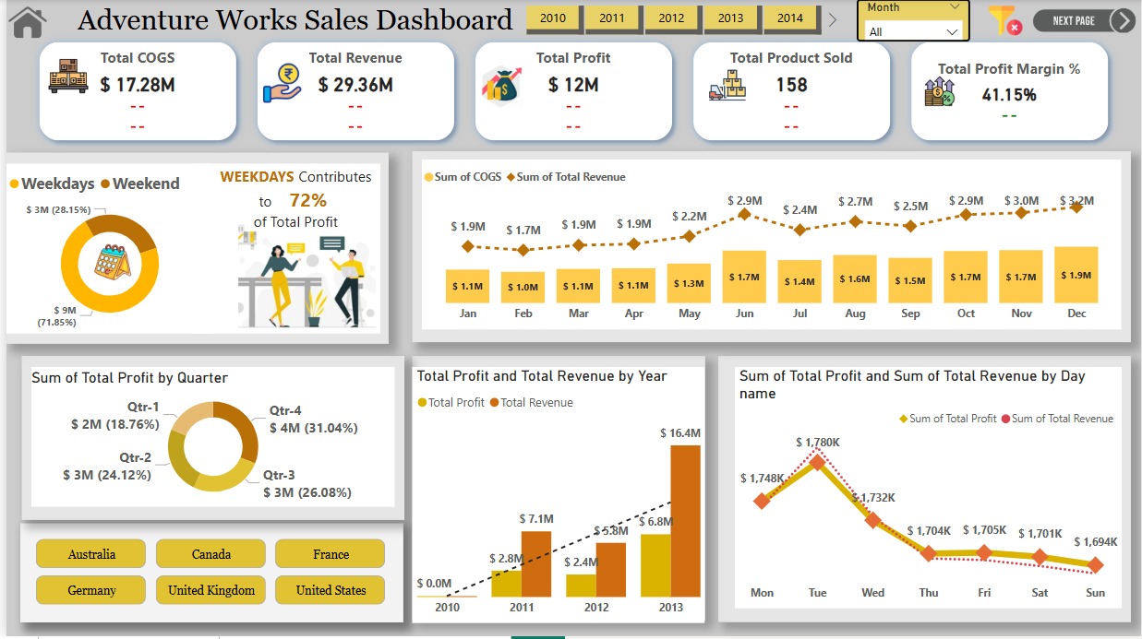
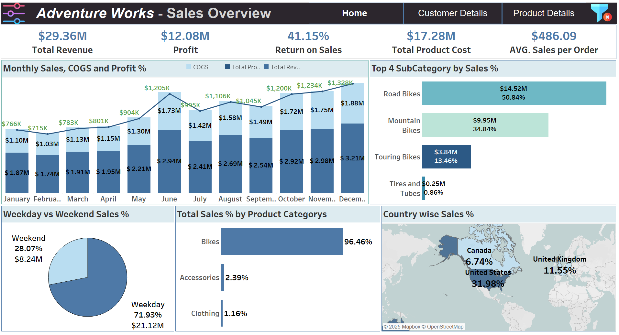
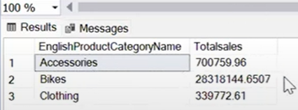
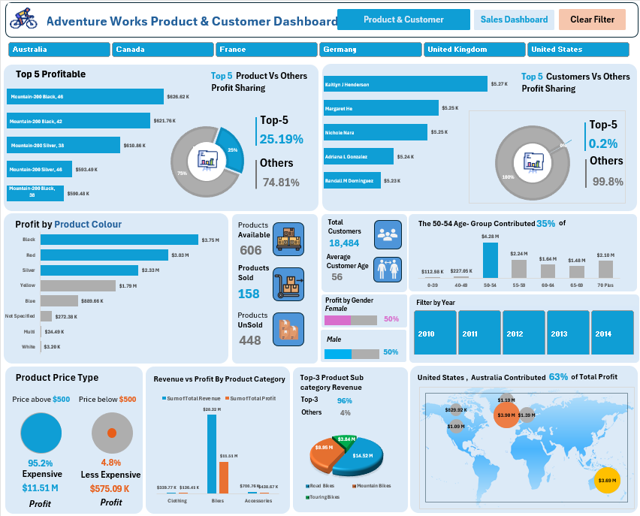
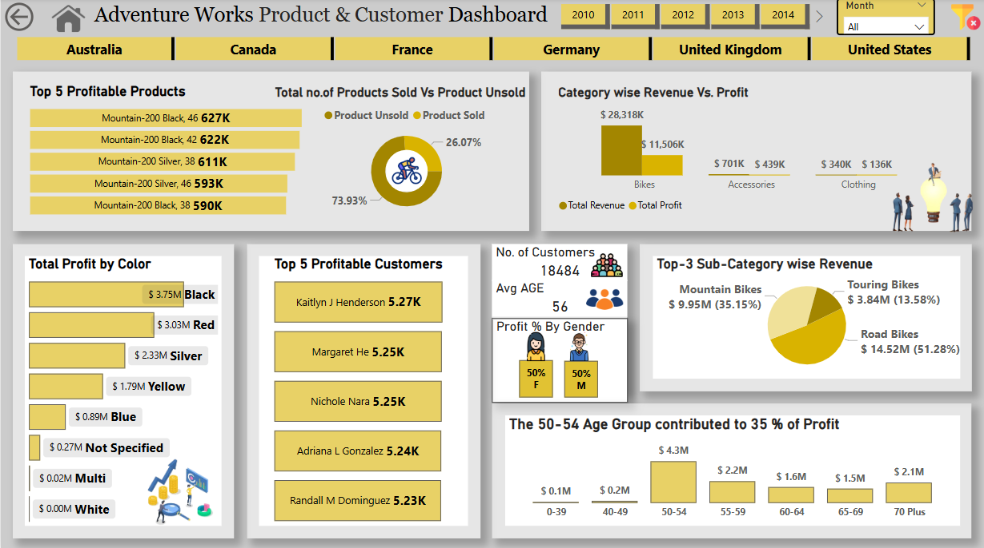
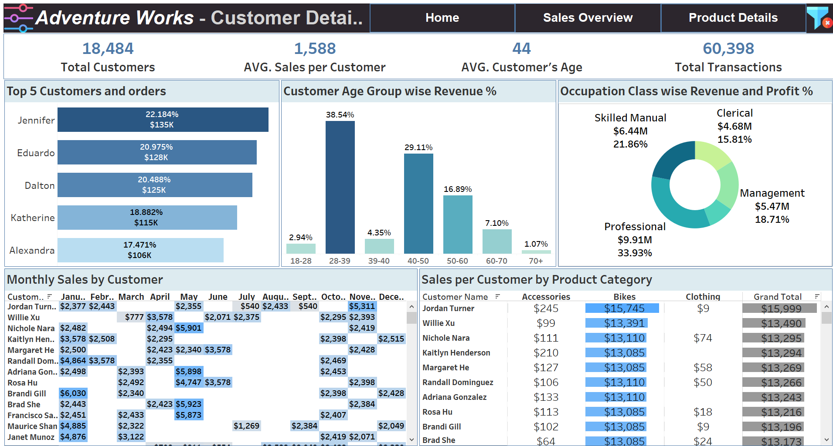
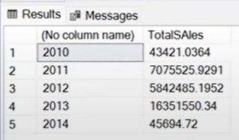
Technologies Used
Excel
We started with data cleaning and preprocessing using Power Query. Identified (KPIs) and created an interactive Excel dashboard to analyze trends.
MySQL
Performed advanced data querying and transformation.
Power BI
Created interactive dashboards, leveraging DAX calculations and advanced visualizations for deeper insights.
Tableau
Lastly, we used Tableau for advanced trend analysis and geographical data visualization.

Slide 6
Dashboard Description
Time Analysis
Product and Customer Analysis
The first dashboard provides a comprehensive time analysis, featuring key performance indicators (KPIs), profit margins, transaction trends, and revenue insights. It enables us to explore sales performance across various dimensions, including country, month, year, quarter, and weekday versus weekend trends.
The second dashboard highlights the top five most profitable products, along with profit distribution by color, product pricing categories, and a detailed analysis of customers and products. It allows us to examine profit trends based on product color and pricing, distinguishing between high-end and budget-friendly items.

Slide 7
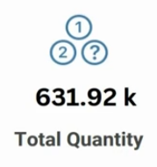
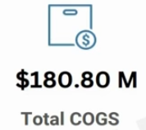
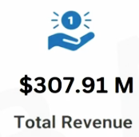
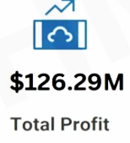
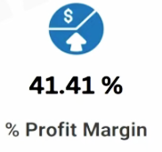
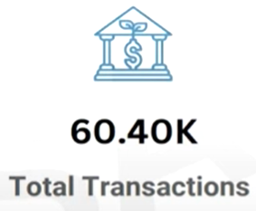
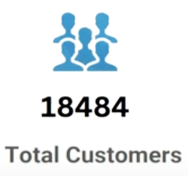
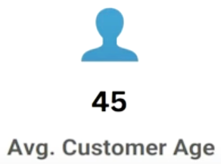
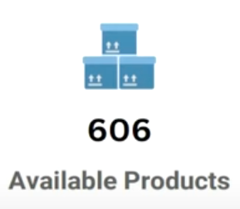
Key Performance Indicator (FY 2010-2014)
60.3
17.28
29.36
12.08
41.15
56

Slide 8
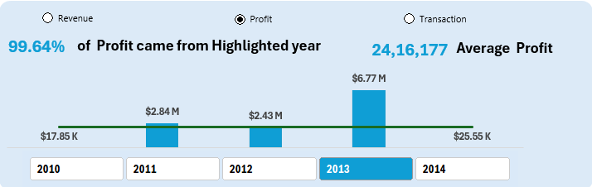
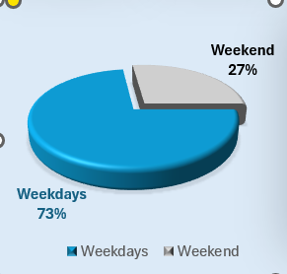
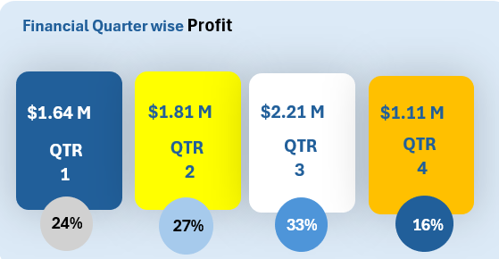
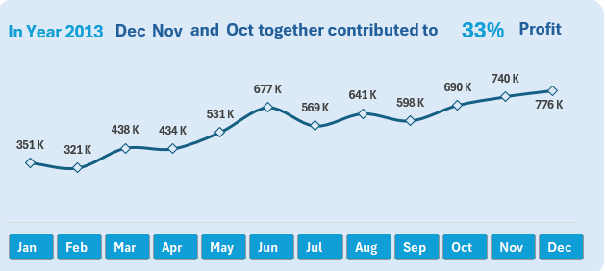
Sales Performance Analysis
1
2
3
4
-
Weekday vs. Weekend Sales Analysis Weekdays contribute 73% of total sales, while weekends account for only 27%.
This indicates that the majority of transactions and revenue occur during working days, possibly due to B2B sales or consumer behavior favoring weekday purchases.
Quarterly Profit Distribution The highest profit was recorded in Q3 ($2.21M, 33%), followed by Q2 ($1.81M, 27%).
Q4 had the lowest profit share (16%), which may indicate seasonal slowdowns or lower demand.
Q1 contributed 24% of the total profit, showing a moderate sales trend.
Monthly Profit Trend in 2013
October, November, and December together contributed 33% of the annual profit, highlighting a strong year-end performance.
The highest profit month was December (776K), followed by November (740K).
There was a consistent growth trend from March to December, showing an increase in sales momentum throughout the year.
Profit Contribution by Year (2013 was the most profitable year, contributing 99.64% of the total profit across all years.
The highest profit recorded in 2013 was $6.77M, significantly surpassing other years.
The years 2010 and 2014 had minimal profits, indicating either lower sales or high costs.

Slide 9
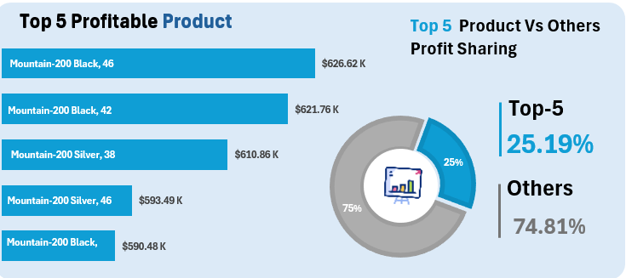
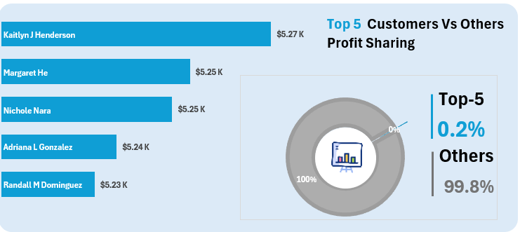
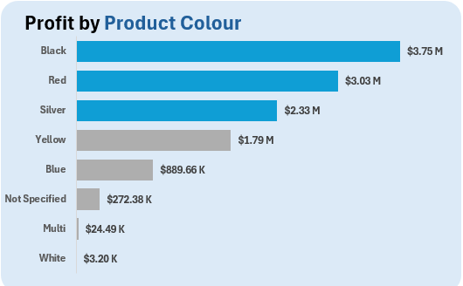
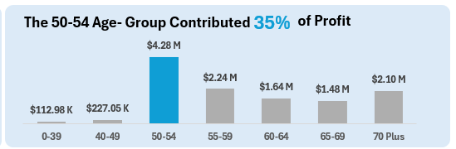
Product & Customer Analysis
1
2
3
4
-
Top 5 Customers Profit Contribution
The top 5 customers contribute only 0.2% of the total profit, while 99.8% of profit comes from other customers.
Profit by Product Colour (Black-colored products generate the highest profit ($3.75M), followed by Red ($3.03M) and Silver ($2.33M).
Yellow, Blue, and other colors contribute comparatively less.
Profit Contribution by Age Group The 50-54 age group contributes the highest profit (35%), totaling $4.28M.
The 45-49 and 55-59 age groups also show strong profit generation, while younger (0-39) and older (70+) age groups contribute the least.
Top 5 Profitable Products (First Visual)
The "Mountain-200 Black, 46" is the most profitable product, generating the highest profit.
The top5 products contribute 25.19% of the total profit, while other products make up 74.81%.

Slide 10

Data Highlights
Total revenue: $29.36M with a profit margin of 41.15%
72% of total profit is generated on weekdays
Highest profit in 2013 ($8.77M)
50-54 age group contributes 37% of sales
Mountain Bikes are the most profitable product

Slide 11
Key Findings
1. Weekdays drive revenue (72%)
2. Seasonal spikes in Q2 & Q3
3. US & Australia are strongest markets
4. Middle-aged customers (50-54) are key spenders
5. Mountain Bikes dominate sales

Slide 12







Recommendations & Actions
Weekend Marketing Campaigns Implement targeted promotions and discounts during weekends to boost customer engagement and increase sales volume.
Promotions for the 50-54 Age Group Launch special discounts or loyalty programs tailored to this demographic, based on data indicating strong purchasing potential.
Expand High-Selling Product Lines – Increase stock and optimize supply chain efficiency for best-selling products to maximize revenue and meet customer demand.
Short-Term Actions:

Slide 13

Recommendations & Actions
Product Diversification – Introduce new product variants or complementary items based on market demand and consumer preferences to reduce dependency on a limited product range.
Enhance Sales Strategies in Weak Regions – Identified underperforming geographical areas needs to strengthen distribution channels, local marketing efforts, and customer engagement strategies.
Data-Driven Pricing Strategies – Leverage historical sales data and competitor analysis to optimize pricing models, ensuring competitive yet profitable price points.
Long-Term Actions:

Slide 14

Conclusion & Next Steps
This analysis provides a roadmap for improving sales,profitability and engagement.
Next steps include implementing recommendations and tracking KPIs.

Slide 15
Team Acknowledgment & Credits
Special thanks to our team for their efforts.
Team Members: [Vijay Sharma, Bhakti, Yakesh]
Project Lead: Pratham Chavan, Sonam Bhanarkar, Jayesh Bedse

Slide 16

Thank you

